Slide 1

Difference-in-Differences Analysis to Evaluate the Health Effects of Pandemic-Era Safety Net Policies
Webinar, Society for Epidemiologic Research
November 13, 2024
Rita Hamad, MD, PhD Associate Professor, Department of Social and Behavioral Sciences Director, Social Policies for Health Equity Research (SPHERE) Center

Slide 2
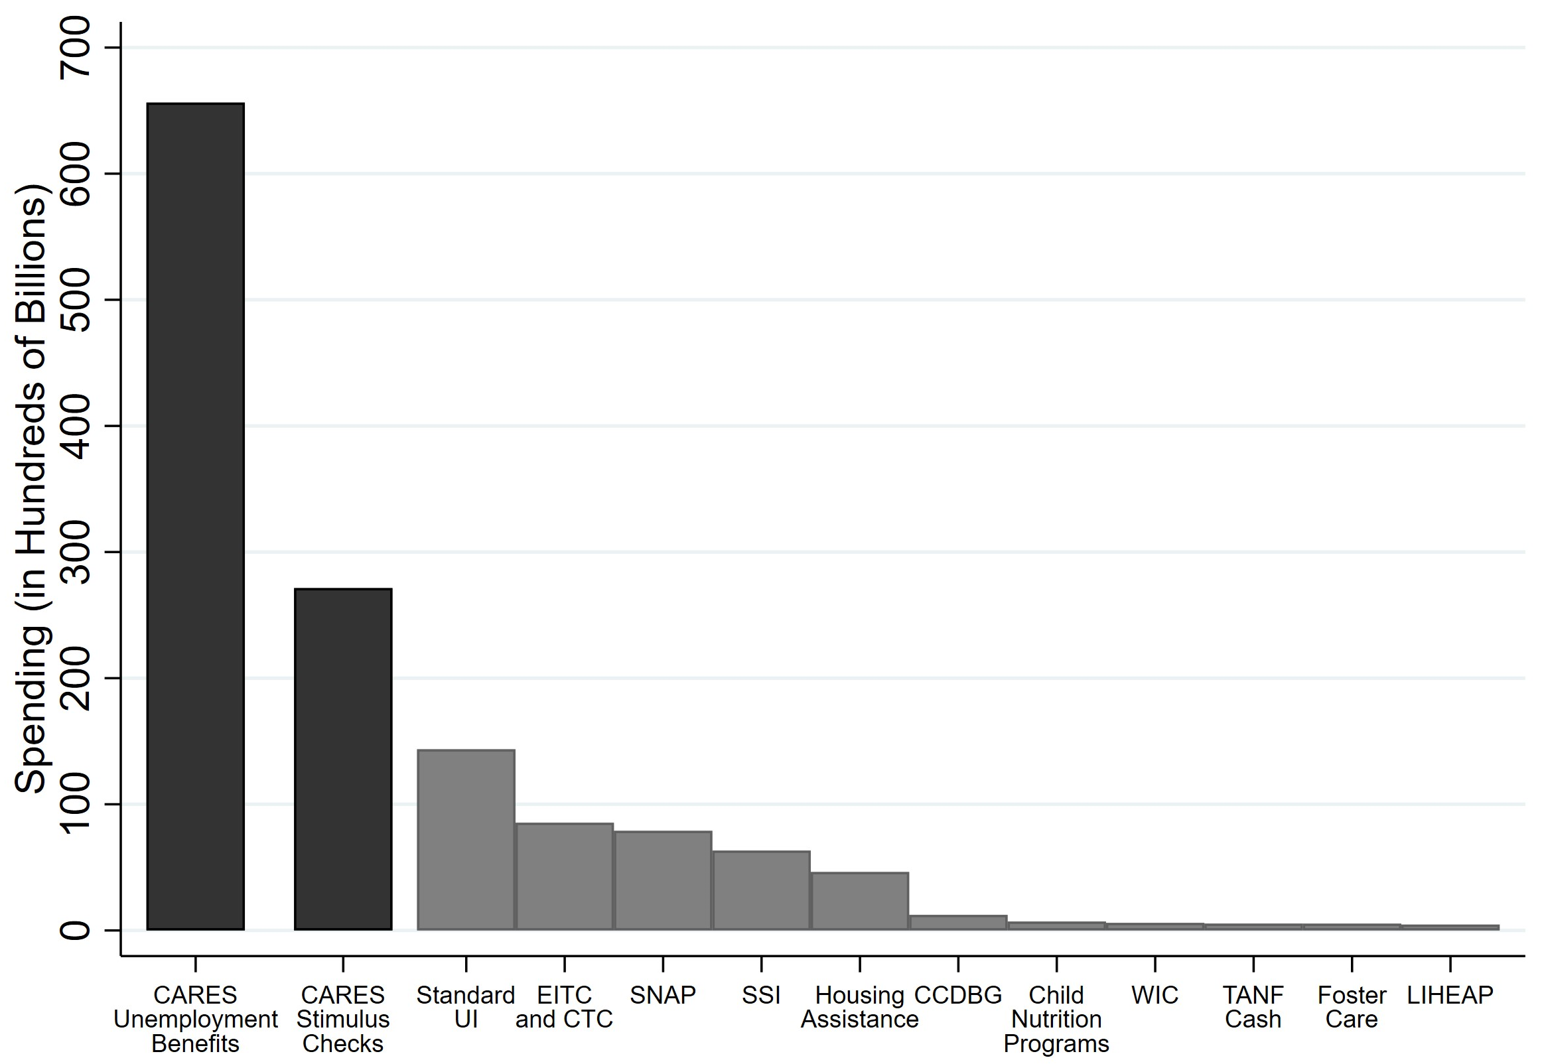
Unprecedented Spending on Social Safety Net
American Rescue Plan Act, 2021
(stimulus checks, CTC/SNAP expansions)
Adapted from Parolin, Poverty in the Pandemic 2023
Notes:
The COVID-19 pandemic and related mitigating policies like workplace closures brought about tremendous economic hardship in the US. To buffer families from this material hardship, state and federal governments engaged in unprecedented spending on social safety net policies. For example, here you see funding amounts for the largest US safety net policies in a typical year, including unemployment insurance, the earned income tax credit and child tax credit, the Supplemental Nutrition Assistance Program, etc. During 2020 [CLICK], Congress passed the CARES Act, which increased unemployment benefits and provided stimulus checks that dwarfed this prior spending. I’ve also added to this figure spending on the American Rescue Plan Act of 2021 [CLICK], which again dwarfed spending in a typical year. ARPA included another round of stimulus checks, as well as expansions to the child tax credit and SNAP. As a bit of background, most of my team’s research agenda focuses on examining the effects of US safety net policies on health equity. So when these major policy changes happened, we were perfectly situated with the data and technical expertise to assess whether these policy changes were having their intended effects on economically disadvantaged families. In particular, the 2021 CTC and SNAP expansions are the two policies that my team has spent quite a bit of energy evaluating, and these are the studies I’m going to share today. Both of them involve difference-in-differences analyses.

Slide 3
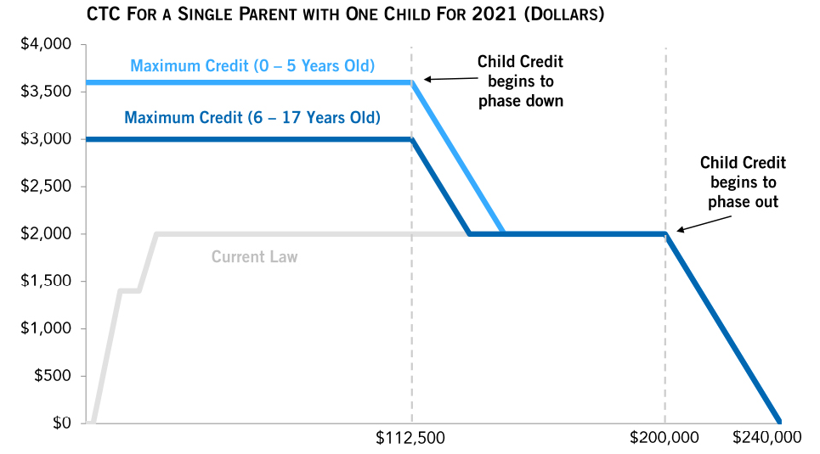
The 2021 Child Tax Credit Expansion
CTC Benefit Size
Household Income
Congressional Research Service, 2021
Notes:
So first, the CTC. To start off with, this figure illustrates how benefits are calculated for the CTC, and it’ll make clear why the 2021 expansion was such a significant policy innovation. The faint gray line is what the CTC looked like pre-2021, and what it looks like now since the expansion expired. You can see that those with zero earned income get nothing, and in fact the benefit isn’t available at all until people start making about $3,000 a year. After that, it starts to phase in, and the largest benefit is available to middle- and even high-income families. The CTC was historically distributed annually as a tax refund when people filed their taxes.
Then in 2021, along came the temporary CTC expansion, shown in blue. This was a major change from the existing policy landscape. Essentially, Congress expanded the CTC to include those with little and even no earned income. In fact, these individuals got the largest benefits, up to $3600 per child, with smaller benefits for those with higher incomes. Also, half of the benefit amount was disbursed monthly during July-December 2021, with the other half disbursed as a lump-sum refund at tax time. This meant that the CTC reached 27 million more children in 2021, or about 90% of American families with kids. It’s estimated to have reduced the rate of child poverty by about 40%. For this study, we were interested in the impact of this policy on parents’ mental health.

Slide 4
Methods: Data Set
U.S. Census Household Pulse Survey
Serial bi-weekly cross-sections Apr 2021-Jan 2022
Individual demographic factors
Mental health outcomes
Depressive symptoms (PHQ), anxiety (GAD)
Mental healthcare use (counseling, medications)
Final N = 812,314
Batra et al., Health Affairs 2023
Notes:
The data set we used for this study was the U.S. Census Household Pulse Survey. This was set up in response to the COVID-19 pandemic and involves serial cross-sectional biweekly internet surveys that have been administered since April of 2020. For this analysis we restricted the data set to April 2021 to January 2022, which gave us 6 waves of pre-policy data and 7 waves of post-policy data. HPS includes questions about individual demographics to allow us to define our exposed and unexposed populations, as I’ll describe in a minute.
HPS also includes a handful of validated mental health outcomes, which is what we examined in this study, including the 2-item Patient Health Questionnaire for depressive symptoms and the 2-item Generalized Anxiety Disorder questionnaire for anxiety symptoms. We also included two other outcomes on the use of mental health services, including receiving counseling or therapy, and using medications to help with mental health problems.
After restricting the sample to people who provided a response to at least one of the outcomes in question, the final data set included over 800,000 people.

Slide 5
Methods: Difference-in-differences Analysis
Counterfactual change over time in treated group in absence of expansion
Policy
effect
Treated group
(adults with kids)
Anxiety symptoms
Observed change over time
in treated and control groups
Control group
(adults without kids)
Before
CTC expansion (Jul 2021)
After
Batra et al., Health Affairs 2023
Notes:
I’m next going to talk about how we used difference-in-differences analysis for this policy evaluation. Building off Dr. Nandi’s presentation, I’m going to go through this stylized description here to give you a sense of the application of DID to this research question. On the X axis, we have time, and this dotted line represents the intervention, in this case the CTC expansion. On the Y axis is the outcome of interest, in this case anxiety symptoms. These two lines represent the treatment and control groups during the pre-intervention period. In this case, we defined the treatment group as adults with children in the household. The control group was adults without children. Then in the post-intervention period, [CLICK] we have the observed change over time in the treatment and control groups. Essentially, [CLICK] DID then extrapolates that the trend in the treatment group would have remained the same as the trend in the control group had the intervention not occurred. Any deviation that we see between observed and expected is the treatment effect of the intervention. [CLICK] This is analogous to an RCT, except that the treatment assignment is of course not truly random.
DID relies on a few assumptions. One is that the two groups would be similar in the absence of the intervention. Of course, many people may rightfully be thinking that it doesn’t make sense to have people without kids be the control group for people with kids, since they differ in lots of ways. But DID assumptions don’t require that the groups be identical on observed characteristics. Rather the assumptions require that the slopes would remain parallel in the absence of the intervention, which is known as the parallel trends assumption. This counterfactual of course can’t be empirically tested, but we can check whether the slopes were parallel in the pre-period. We can also check whether there are differential compositional changes in the two groups over time, to make sure that compositional changes aren’t driving results. I’ll briefly review how we assessed the validity of those assumptions in this case, and you can take a look at the paper for more details.

Slide 6

Empirical Models
Standard difference-in-differences model:
$$MentalHealth=β_{0}+β_{1}Children×Post+β_{2}Children+β_{3}Post+β_{4}Covars+β_{5}Week+ε$$
Difference-in-difference-in-differences model:
$$MentalHealth= β_{0}+ β_{1}Post×Children×Lowincome+$$
$β_{2}Children×Lowincome+β_{3}Children×Post+β_{4}Lowincome×Post+$
$β_{5}Children+β_{6}Post+β_{7}Lowincome+β_{8}Covars+β_{9}Week+ε$
Batra et al., Health Affairs 2023
Notes:
I’m next going to share the empirical model to show what the analysis is actually doing. Diff-in-diff essentially involves regressing each outcome on an interaction term between whether an individual has children, and whether the observation was recorded after the CTC expansion. We adjusted for other individual-level covariates, and fixed effects (i.e., indicator variables) for survey week. These fixed effects account for secular changes, which are underlying temporal trends that affect all people similarly because of things related to the pandemic or something else. [CLICK] Here beta-1 is the coefficient of interest, and it estimates the effect of the CTC expansion on these outcomes.
This analysis actually took diff-in-diff one step further to carry out a difference-in-difference-in-differences, or triple-difference model. [CLICK] Here we wanted to leverage the fact that the lowest-income individuals actually received the largest CTC benefit, and were not eligible before the expansion, so we would expect to see a larger effect in this group, while the highest earners didn’t receive any CTC benefit. Here, we defined low-income as those making less than $35,000 a year. Triple-difference analysis therefore involves a triple-interaction term, [CLICK] with beta-1 again as the coefficient of interest, and adjusting for each of the double-interaction and main terms, plus the covariates and fixed effects for survey week.

Slide 7
Results: HPS Sample Characteristics
 | Before July 15,2021 |  | After July 15,2021
 | Adults without children | Adults with children | Adults without children | Adults with children
Covariates | Mean (SD) or Percent
Age | 57.3 (15.3) | 44.8 (11.9) | 56.1 (15.9) | 44.0 (11.9)
Male | 42.7 | 36.9 | 42.9 | 36.6
Married | 53.9 | 70.7 | 52.7 | 69.9
High school or less | 11.9 | 13.1 | 12.2 | 13.2
Income
Less than $25,000 | 10.7 | 8.9 | 11.7 | 9.5
$25,000, $34,999 | 8.9 | 7.6 | 9.3 | 7.5
$35,000, $49,999 | 10.9 | 8.9 | 11.4 | 9.0
$50,000, $74,999 | 18.2 | 14.9 | 18.1 | 14.6
$75,000, $99,999 | 14.8 | 13.9 | 14.6 | 13.7
$100,000, $149,999 | 17.9 | 20.4 | 17.3 | 20.3
$150,000, $199,999 | 8.8 | 10.6 | 8.2 | 10.8
$200,000 and above | 9.8 | 14.8 | 9.5 | 14.5
Race/Ethnicity
Non-Hispanic White | 79.3 | 66.9 | 78.9 | 68.6
Non-Hispanic Black | 6.3 | 8.5 | 6.4 | 8.7
Hispanic | 7 | 11.9 | 4.4 | 6.5
Asian | 4.5 | 6.8 | 6.4 | 10.4
Other | 3.9 | 5.7 | 3.9 | 5.8
Mental Health Outcomes
Depressive symptoms (≥3) | 16.4 | 18.4 | 17.2 | 19.9
Anxiety symptoms (≥3) | 20.1 | 25.5 | 21.6 | 29.3
Mental health services | 16.5 | 21.8 | 18.4 | 23.3
Mental health prescription | 22.4 | 23.6 | 23.9 | 24.6
N | 237,901 | 112,862 | 316,122 | 145,429
Batra et al., Health Affairs 2023
Notes:
This table illustrates the sample characteristics, broken down by whether the individual was observed before or after the CTC expansion, and whether or not they had children in the household. You can see that adults with children are more likely to be younger, female, married, with lower educational attainment. They have a different income distribution, and are less likely to be white. As I mentioned, though we don’t need these two groups to be identical on these observations. One assumption is that the composition of these groups didn’t change differently over time. We did find a few minor differences, for example, the treatment group was slightly less likely to be male in the post period. However, the magnitude of these changes was very small. We adjust for all these covariates in our models, but one limitation of DID is that there is always the possibility of compositional changes in important unobserved characteristics.

Slide 8
Assessment of Parallel Trends Assumption
Note: Sample was drawn from the April 2021 to January 2022 waves of the U.S. Census Household Pulse Survey. Sample includes 812,314 participants who provided responses to the outcomes of interest.
Batra et al., Health Affairs 2023
Notes:
Meanwhile, this figure illustrates the results of the analysis checking whether trends between the treatment and control groups were different in the pre-expansion period. Here we found parallel trends, and they were also parallel for the other outcomes not shown here.

Slide 9
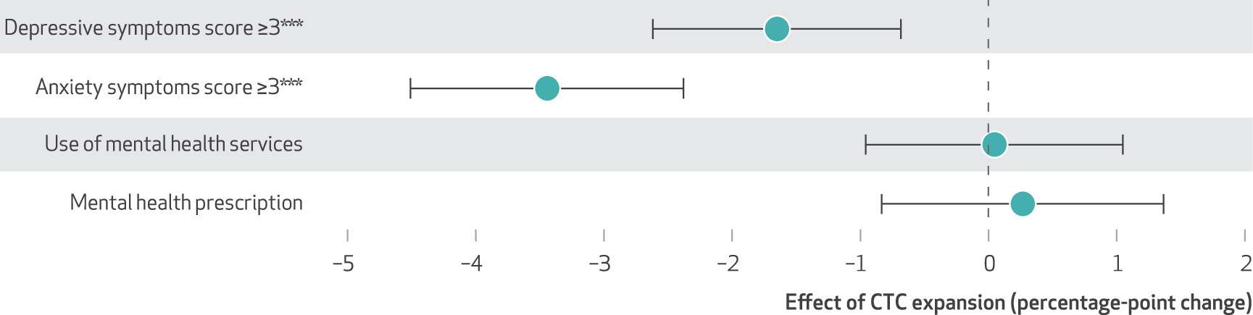
Results: Effects of 2021 CTC Expansion on Mental Health
*** p < 0.01
Note: Sample was drawn from the April 2021 to January 2022 waves of the U.S. Census Household Pulse Survey. Sample includes 812,314 participants who provided responses to the outcomes of interest.
Batra et al., Health Affairs 2023
Notes:
Here are the main results. We found that among low-income people with children after the CTC expansion relative to other groups, there was a reduction in depressive symptoms of about 1.7 percentage points or 9% from baseline, and a reduction in anxiety symptoms of 3.4 percentage points or 13% from baseline. We couldn’t reject the null hypothesis of no association for the mental healthcare utilization outcomes.

Slide 10
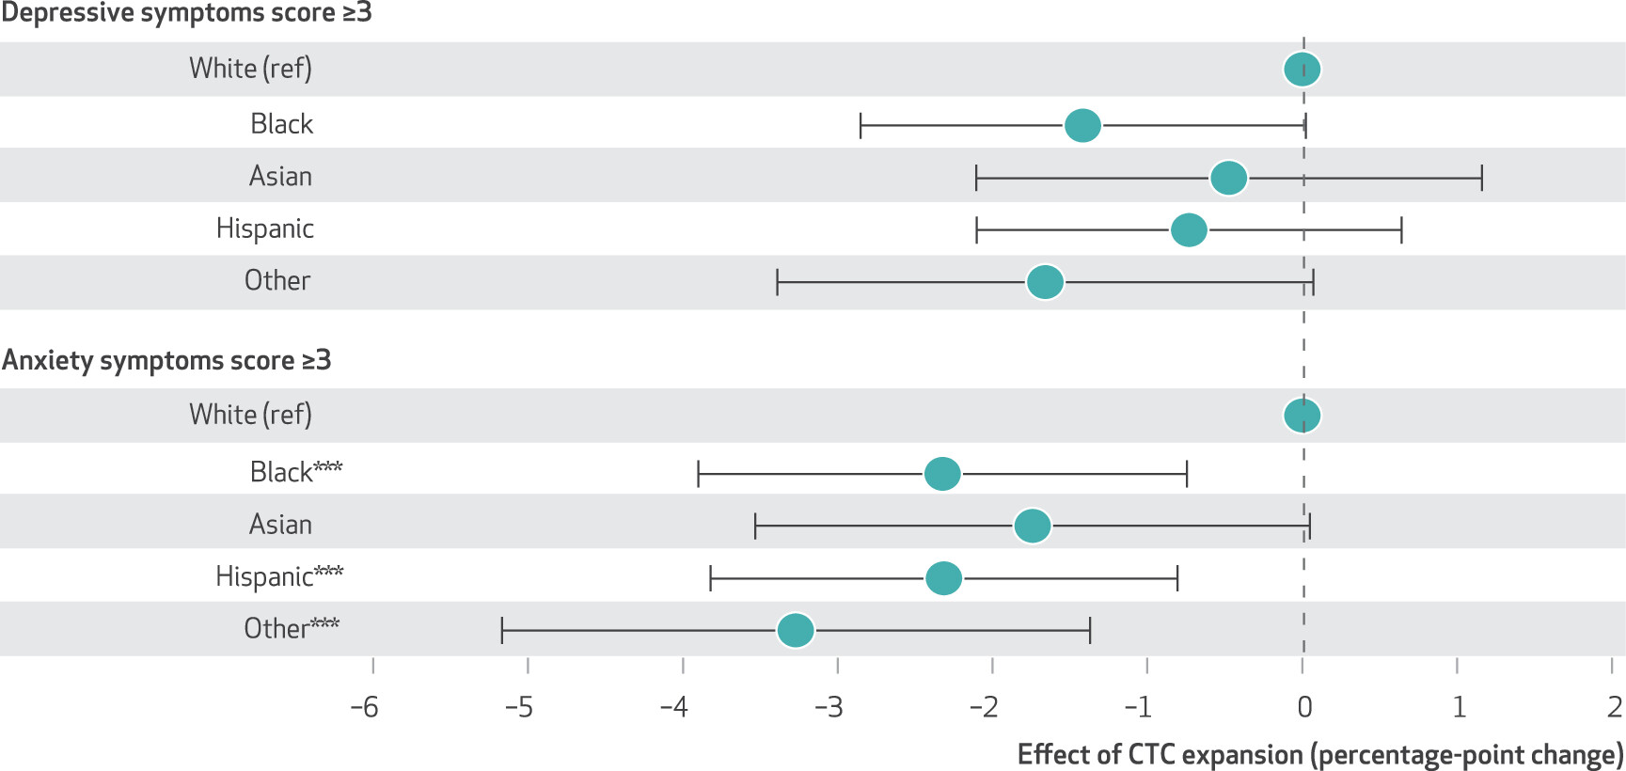
Results: Effects of 2021 CTC Expansion on Mental Health, by Race/Ethnicity
*** p < 0.01
Note: Sample was drawn from the April 2021 to January 2022 waves of the U.S. Census Household Pulse Survey. Sample includes 812,314 participants who provided responses to the outcomes of interest.
Batra et al., Health Affairs 2023
Notes:
We were also interested in differences in the effects of the policy by race and ethnicity. For example, Black families have less wealth than White families due to current and historical policies like redlining, such that an income boost may be more impactful. Also, Hispanic families are less likely to be eligible for other safety net policies because of restrictions related to immigration status, while the CTC is available to parents of any immigration status as long as the child has a social security number.
[CLICK] In this analysis we compared effects among different racial and ethnic groups to the effects among White individuals serving as the reference category. Here we found a reduction in depressive symptoms among Black people, and reductions in anxiety symptoms among Black and Hispanic people and those of other racial/ethnic subgroups.
[[We weren’t able to further disaggregate this last group because of small cell sizes, and they obviously represent a very heterogeneous group. I always like to point this out, since I am in this Other group, and it’s frustrating that we can’t say more about them… or us.]]

Slide 11
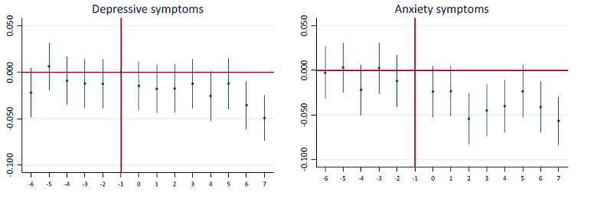
Results: Effects of 2021 CTC Expansion on Mental Health, Event Study Models
Survey waves since CTC expansion
Survey waves since CTC expansion
Note: Sample was drawn from the April 2021 to January 2022 waves of the U.S. Census Household Pulse Survey. Sample includes 812,314 participants who provided responses to the outcomes of interest.
Batra et al., Health Affairs 2023
Notes:
For our next analysis, we conducted an event study, which is similar to DID except that we look at time more granularly. This allowed us to show that depressive symptoms took a couple of months to begin to improve, while anxiety symptoms dropped more quickly.

Slide 12
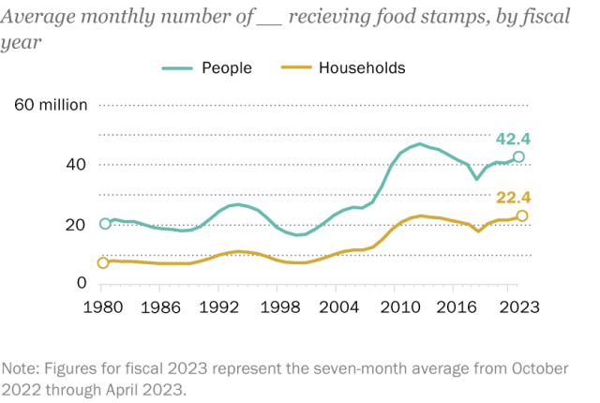
The Supplemental Nutrition Assistance Program
Average benefit in 2021:
$127 per person per month
Additional benefit in 2021 from
pandemic-era “emergency allotments”:
$92 per person per month
Pew Research Center, 2023; Center on Budget and Policy Priorities, 2023
Notes:
I’m now going to pivot to another safety net policy that was expanded substantially during the pandemic, the Supplemental Nutrition Assistance Program, or SNAP, which was formerly known as food stamps. Even prior to the pandemic, SNAP supported around 20 million households or 40 million people per year. There was a surge in enrollment during the pandemic, largely due to more people qualifying because of new economic hardship. There were also expansions to increase the generosity of SNAP benefits [CLICK]. The average baseline benefit size in 2021 was $127 per person per month, and temporary COVID-era “emergency allotments” (as they were known) added another *$92* per person per month.

Slide 13
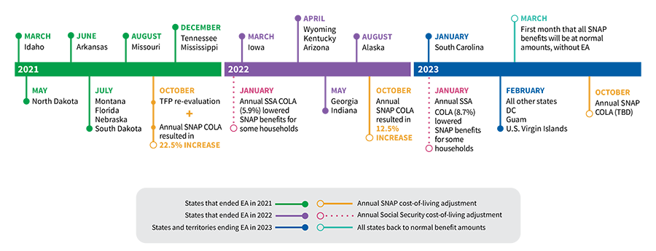
Staggered Expiration of SNAP EAs by State
US Department of Agriculture, 2023
Notes:
At the same time, states had the ability to decide to terminate these benefits according to their own timeline. You can see here the states that began to terminate these emergency allotments as early as March 2021, with others following suit over the following years. By March 2023, there were only 35 states who still had these expanded SNAP emergency allotments in place. [CLICK] At that point, the federal government announced the end of the COVID-19 public health emergency, and these benefits were discontinued in these remaining states. This expiration of benefits in March 2023 is the one that we examined in this next study, to understand how it affected food insufficiency and other related outcomes among SNAP recipients.

Slide 14
Methods: Data Set
U.S. Census Household Pulse Survey
Serial ~monthly cross-sections Nov 2022-Jul 2023
Individual demographic factors
Outcomes
Food and material hardship
Depressive symptoms (PHQ), anxiety (GAD)
Restricted to individuals eligible for SNAP based on self-reported demographics
Final N = 41,517
Wells et al., Health Affairs 2024
Notes:
We again used the US Census Household Pulse Survey. At this point, the serial cross-sectional surveys were being conducted monthly, and we used data from November 2022 to July 2023 to get 4-5 waves in each of the pre- and post-expiration periods. We used individual demographic factors to identify individuals who would be eligible for SNAP based on federal and state income limits. Here our outcomes included food insufficiency, food pantry use, difficulty paying household and housing expenses, and mental health. We restricted the sample to those who were eligible for SNAP based on self-reported demographics, for a final sample size of about 41,000.

Slide 15
Methods: Difference-in-differences analysis
Counterfactual change over time in treated group in absence of expansion
Effect of
expiration
Treated group
(SNAP recipients)
Food insufficiency
Observed change over time
in treated and control groups
Control group
(SNAP-eligible non-recipients)
Before
SNAP Expiration (Mar 2023)
After
Wells et al., Health Affairs 2024
Notes:
As before, we used difference-in-differences, and here again is our stylized figure to explain the setup. In this case, here along the X axis you see the time periods before and after the SNAP expiration. The Y axis is food insufficiency, our main outcome. The treatment group is SNAP recipients, who would have suddenly experienced a decrease in benefit size. And the control group is individuals who are eligible for SNAP based on their income, but who did not self-report SNAP receipt. About a fifth of people who are eligible for SNAP do not receive the benefits that they qualify for, so this is a sizable control group. Again, in the post-intervention period, [CLICK] we have the observed change over time in the treatment and control groups. And again, [CLICK] DID then extrapolates that the trend in the treatment group would have remained the same as the trend in the control group had the intervention not occurred. This deviation is the treatment effect as a result of the expiration [CLICK].

Slide 16
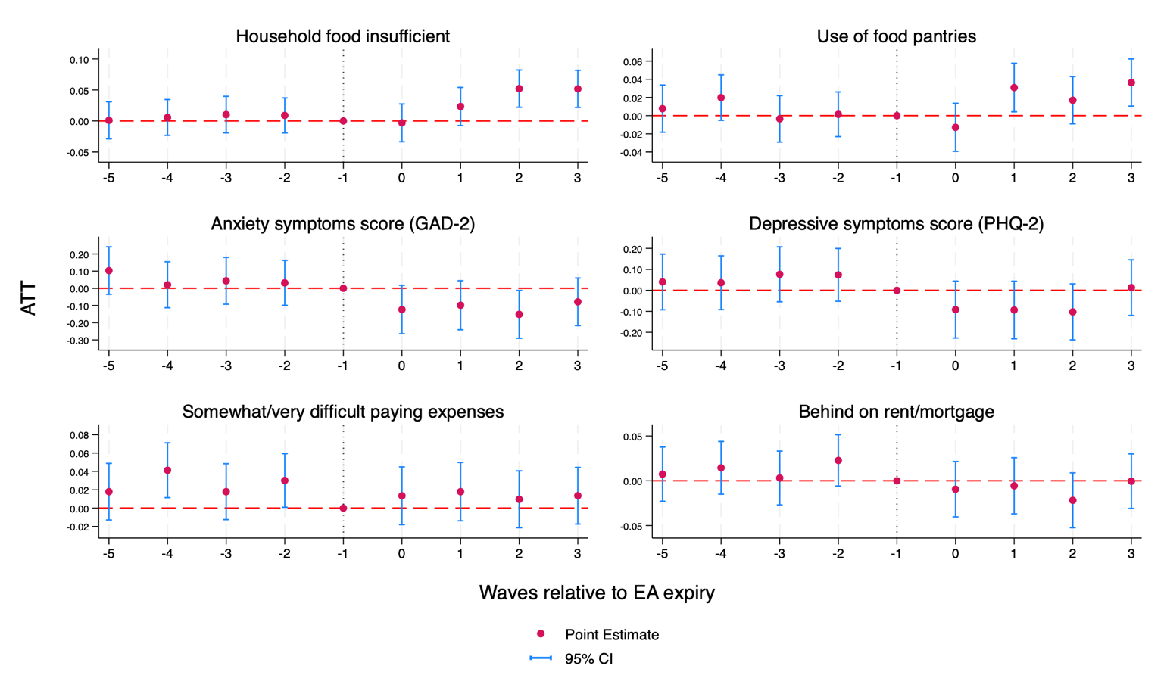
Results: Evaluation of Parallel Trends Assumption
Note: Sample was drawn from the Nov 2022 to July 2023 waves of the U.S. Census Household Pulse Survey. Sample includes 41,517 participants who provided responses to the outcomes of interest.
Wells et al., Health Affairs 2024
Notes:
As a reminder, one is that the two groups would be similar in the absence of the intervention. Again, SNAP-eligible individuals who do not take up their benefits may differ in meaningful ways from those who do receive them. In this figure, I’m showing you the results of an event study analysis, to evaluate the validity of the parallel trends assumption. Based on the fact that the confidence intervals during the pre-expansion period include the null, this suggests that the trends for the recipients and non-recipients were parallel. This was similar for the other outcomes, which I won’t show here. This figure also starts to suggest the main findings, since you can see that food insufficiency and use of food pantries began to rise in the post-expiration period.

Slide 17
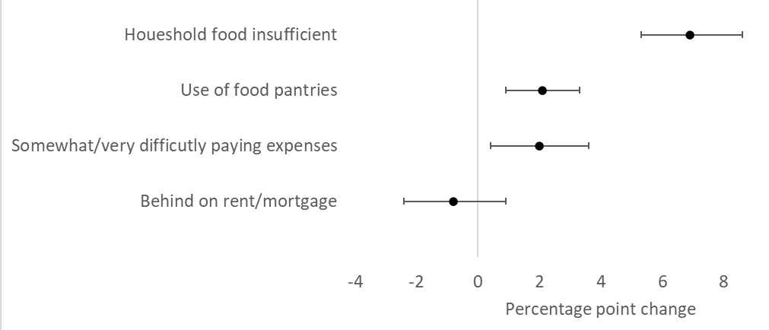
Results: Effects of SNAP Emergency Allotment Expiration on Food and Material Hardship
Note: Sample was drawn from the Nov 2022 to July 2023 waves of the U.S. Census Household Pulse Survey. Sample includes 41,517 participants who provided responses to the outcomes of interest.
Wells et al., Health Affairs 2024
Notes:
Here are the results of the difference-in-differences analysis, showing a 7 percentage-point increase in food insufficiency, which is about a 10% change from baseline. We also found 2 percentage-point increases in food pantry use and difficulty paying expenses. We didn’t see a change in mental health in the sample overall. Those null results aren’t shown here.

Slide 18
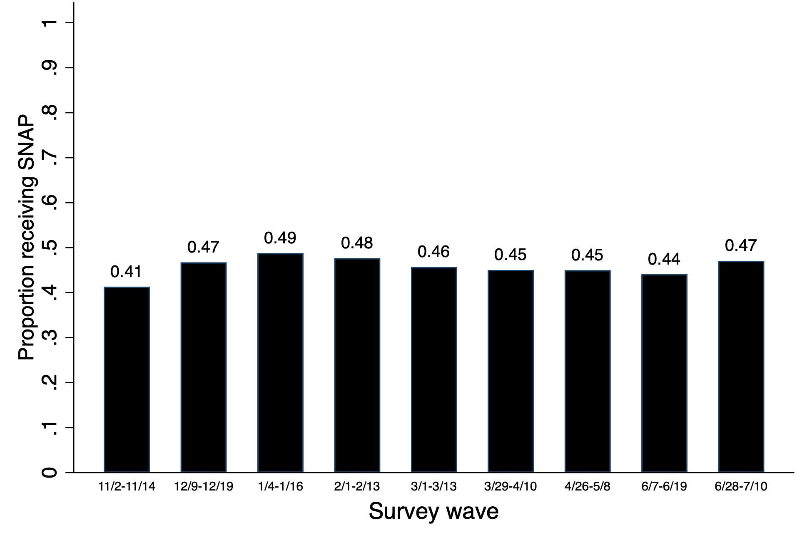
Results: Proportion of SNAP-eligible individuals self-reporting SNAP receipt, by survey wave
Expiration of
emergency allotments
Note: Sample was drawn from the Nov 2022 to July 2023 waves of the U.S. Census Household Pulse Survey. Sample includes 15,585 participants who provided responses to the outcomes of interest.
Wells et al., Health Affairs 2024
Notes:
We also wanted to ensure that there were no differential changes in composition of the treatment versus control groups over time that might be explaining the results. Here we plotted out the proportion of SNAP-eligible individuals who self-reported SNAP receipt, by survey wave. There are two main take-aways from this figure. First, it shows that there were no dramatic changes in self-reported SNAP receipt with the expiration of the emergency allotments. Also, not shown here, there were no differential compositional changes in demographic characteristics of the treatment versus control groups before versus after the benefits expired. Second, it confirms the measurement error in our “treatment” group, because we know that actual SNAP take-up is higher than this. This suggests that our control group is contaminated with people who actually did receive SNAP, meaning that our results are probably biased towards the null, and the true effect size may be larger.

Slide 19
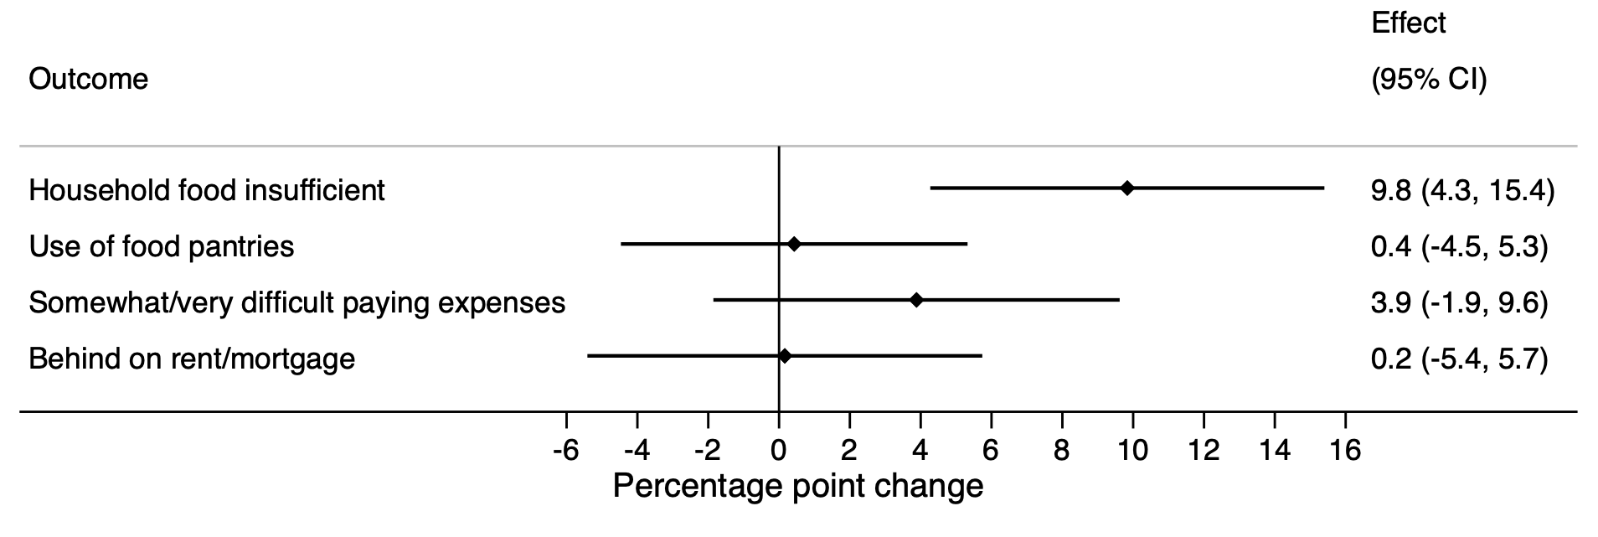
Results: Effects of SNAP Emergency Allotment Expiration on Food/Material Hardship, Sample Restricted to EITC-eligible Individuals
***
*** p < 0.01
Note: Sample was drawn from the Nov 2022 to July 2023 waves of the U.S. Census Household Pulse Survey. Sample includes 15,585 participants who provided responses to the outcomes of interest.
Wells et al., Health Affairs 2024
Notes:
As we’ve been discussing today, another thing we want to try to rule out is that there are no other co-occurring policies that may be confounding the association between the policy and outcomes of interest. In this case, we might be worried about tax refunds that people receive in spring of each year, and in particular that some people may be receiving payments for the Earned Income Tax Credit, or EITC, which is the largest poverty alleviation program. If SNAP recipients and non-recipients have different probability of being EITC recipients, this may bias our results. So for this next analysis, we restricted the sample only to those who were EITC-eligible based on self-reported demographics. [CLICK] We still observed impacts on food insufficiency, but the other coefficients were no longer statistically significant. It might be that this is because our sample was now much smaller, so we were underpowered. Or it might be that this group of people was receiving potentially thousands of dollars in EITC benefits at this time, so they were more buffered against the drop in SNAP benefits. We also did several other sensitivity analysis, and I encourage you to check out the paper for more details.

Slide 20
Acknowledgements
Funding: NIH (U01MH129968, R01NR021098)
Collaborators: Akansha Batra, Kaitlyn Jackson, Cindy Leung, Whitney Wells
Notes:
I’d like to end by acknowledging the funders of the work I discussed today, including two NIH grants, and my collaborators on these two studies.

Slide 21
Thank you! Questions?
https://hsph.harvard.edu/sphere

Slide 23
Methods: Multiple Imputation
Missing values: income 10.9%, all others < 1%
Multiple imputation using chained equations
Assumes “missing at random”
Does not require variables to be normally distributed
All covariates (and outcomes) used in imputation models
Produced 30 imputed data sets
Did not use imputed outcomes
Results similar to main analysis
Batra et al., Health Affairs 2023

Slide 24
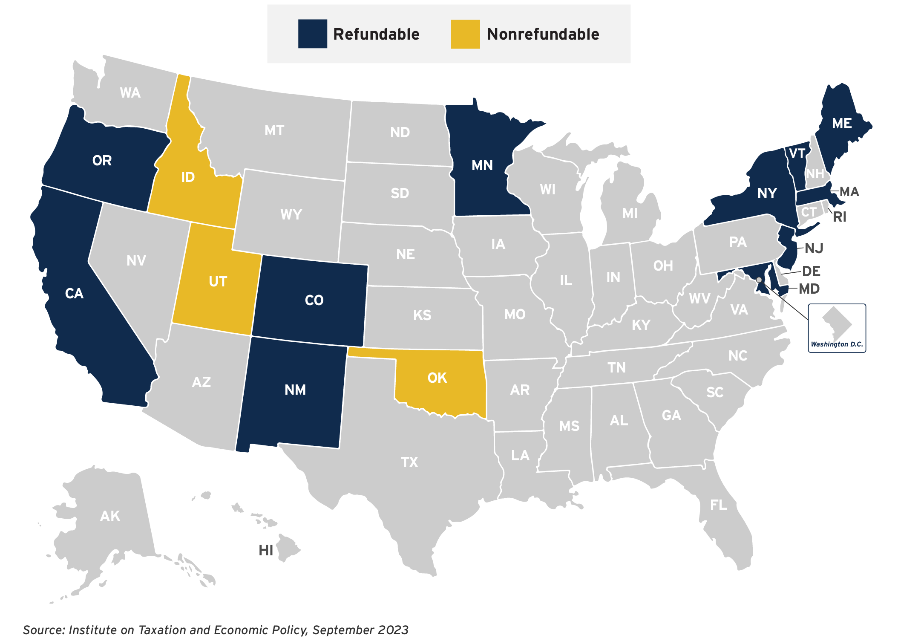
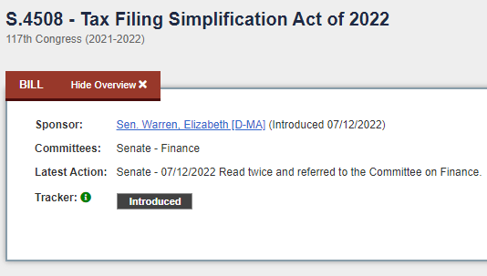
Child Tax Credit: Policy Implications
States Offering Child Tax Credits, 2024
Notes:
Many of you may be thinking, why does this matter, the federal CTC expansion expired, and the current Congress is no shape to revive it. But even I have been surprised lately, since it seems like a trimmer version of the 2021 CTC expansion is back on the table, with a proposal just in the last month seeming like it will gain enough bipartisan support to pass.
And regardless, this is still very much an active policy topic at the state level [CLICK]. This map illustrates the 14 states that now offer their own version of a CTC, and 10 of them were actually created or expanded just in 2023. The Massachusetts child and dependent tax credit was one of the ones that was expanded this past year, and it is now the most generous in the country.
Moreover, there are also policies being considered to address the issue of challenges with low take-up of the child tax credit and the earned income tax credit. [CLICK] In fact, our own Senator Elizabeth Warren introduced the “Tax Filing Simplification Act” in 2022, which would create an online portal to ease tax filing, would create a mechanism for the IRS itself to prepare returns for tax filers, and it has a special focus on facilitating claims for childcare and earned income tax credits. The research that I just presented helps to inform these ongoing policy conversations.

Slide 25
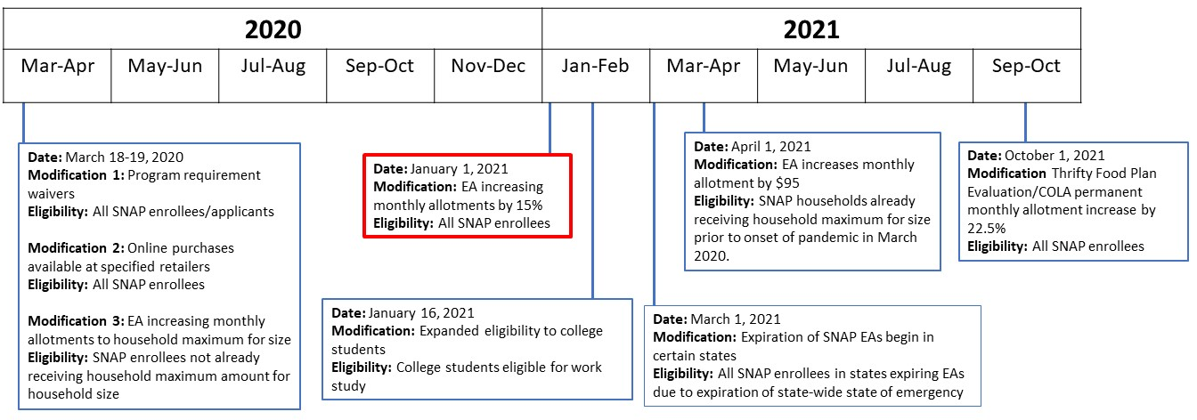
The Rise and Fall of Expanded SNAP Benefits
Compiled from USDA and CBPP reports; SNAP: Supplemental Nutrition Assistance Program;
EA: emergency allotment; COLA: cost of living adjustment
Notes:
There were actually numerous changes to SNAP during this period, mapped out in this timeline. These included allowing online purchases, and increases to benefits of various sizes for different types of families. There’s a lot on this slide, but I’ve highlighted in red one major change that involved a 15% increase in monthly allotments for all SNAP enrollees in January 2021. These emergency allotment expansions were implemented nationally, but they were temporary, and different states began to phase them out at different points in the ensuing two years.

Slide 26
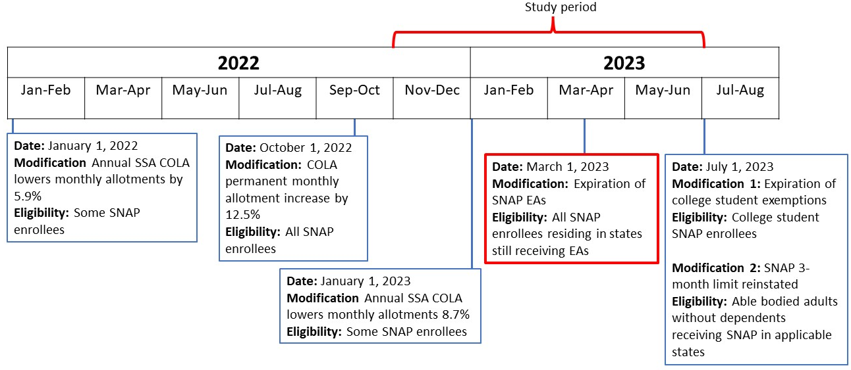
The Rise and Fall of Expanded SNAP Benefits
Compiled from USDA and CBPP reports; SNAP: Supplemental Nutrition Assistance Program;
EA: emergency allotment; COLA: cost of living adjustment; SSA: Social Security Administration

Slide 27
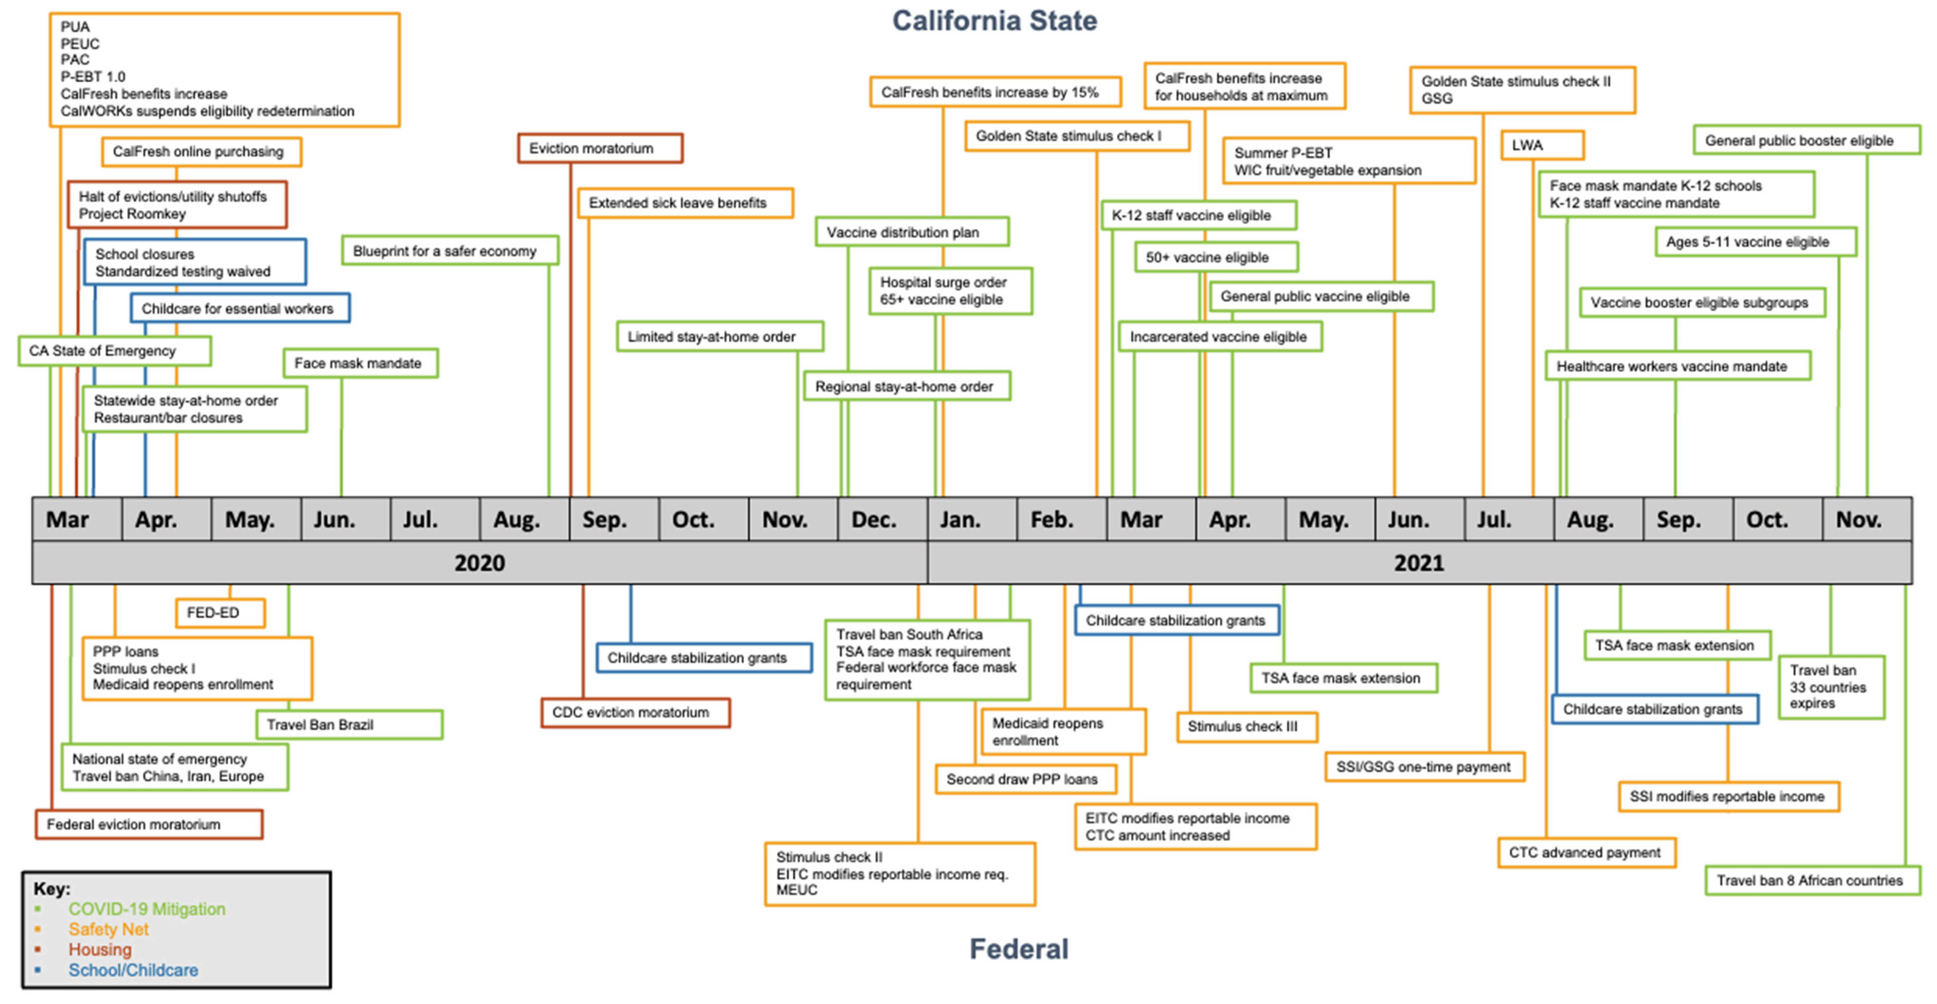
Co-Occurring Pandemic-Era Policies
Jackson et al., IJERPH 2022

