Slide 1

Exploring Epidemiologic and Econometric Approaches to Causal Inference
SERdigital, March 9, 2017
Miguel Hernán
departments of epidemiology and biostatistics

Slide 2
Causal inference from observational data has many dangers
One of them is confounding
  Usually presented as a fundamental threat
  A key difference between randomized trials and observational studies
Confounding adjustment in observational analyses is as an attempt to emulate randomization
  If confounding adjustment is successful, then the observational effect estimate can be interpreted as if exposure had been randomized

Slide 3
Two approaches to adjust for confounding
Correctly measure and adjust for confounders
  Restriction/stratification, regression, matching, propensity scores, standardization/g-formula, g-estimation, IP weighting
Exploit sources of randomness without measuring the confounders
  instrumental variable (IV) estimation, regression discontinuity…

Slide 4
Let us consider a question for which both approaches can be used
Suppose we want to estimate the causal effect of colonoscopy or sigmoidoscopy screening on the risk of
  colorectal cancer incidence
  overall mortality
First, we use observational data

Slide 5
Medicare
Federal health insurance program for people > 65, with disabilities or with ESRD
  About 50 million enrollees per year
Medicare claims dataset (20% random subsample) available for research purposes, years 1999-2012.
  outpatient and inpatient services
  doctor services
  drug prescriptions
Medicare reimburses screening colonoscopy since July 2001
  for people at average risk for CRC without upper age limit

Slide 7
Turned 70-79 in the reference years (2004-2012)
N = 29,504,793
Enrolled in Medicare parts A and B and not in Medicare Advantage in previous 5 yrs
N = 17,860,332
Anemia, N = 2,264,355
GI bleed, N = 666,975
Constipation, N = 563,290
Diarrhea, N = 709,179
Abdominal pain, N = 132,865
Irritated bowel syndrome, N = 213,451
Bowel habits change, N = 145,082
Weight loss, N = 375,886
Ischemic bowel disease, N = 30,795
Diverticular disease, N = 991,155
Other, N = 338,512
Abdominal CT scan (includes colonography), N = 1,069,623
Barium enema, N = 37,676
Standard eligibility criteria
Asymptomatic in the 6 months before inclusion
N=13,154,647
CRC diagnosis, N=316,459
Adenoma/benign lesion, N=2,438,831
Inflammatory bowel disease, N=158,262
Colonoscopy, N=4,268,400
Sigmoidoscopy, N=190,142
FOBT, N=3,370,997
Colectomy, N=112,242
No CRC screening or high-risk features in the previous 5 years
N = 6,185,273
Received at least two of the following in the previous 2 years: influenza vaccine, breast cancer screening, prostate cancer screening
N = 1,891,671
Confounding adjustment via restriction
Colonoscopy arm
N=79,019
Person-months=3,582,105
CRC=1,356
No screening arm
N=3,684,435
Person-months=160,378,718
CRC=50,833

Slide 8
Additional confounding adjustment
Via stratification/regression
  Sex, race, reason of Medicare enrollment, age, use of preventive services, geographic location, comorbidity score, Alzheimer’s/dementia, AMI, asthma, AF, cataracts, CHF, CKD, endometrial cancer, breast cancer, lung cancer, prostate cancer, COPD, depression, diabetes, glaucoma, hip fracture, hyperlipidemia, BPH, hypertension, hypothyroidism, IHD, osteoporosis, osteoarthritis, stroke
Plus appropriate definition of time zero (see paper)

Slide 9
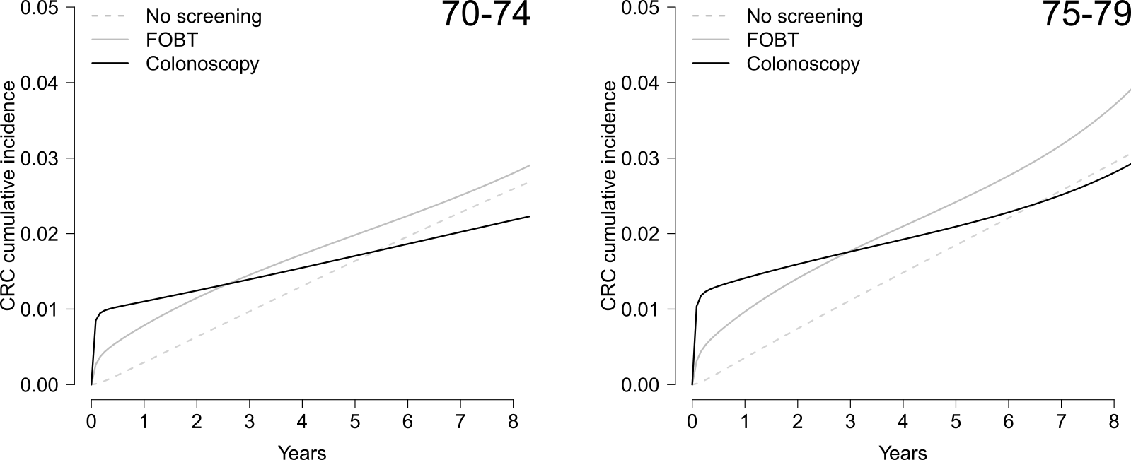
Effect estimate of screening colonoscopy
(vs. no screening colonoscopy) on CRC risk
 | 8-year risk difference (95% CI)
Age 70-74 yrs | -0.42 % (-0.24, -0,63)
Age 75-79 yrs | -0.14 % (-0.41, 0.16)

Slide 10
However…
When the same approach is used to estimate the effect of screening colonoscopy on overall mortality
  Screening colonoscopy appears to increase the mortality risk
Intractable confounding
  End of the road for this approach

Slide 11
Two approaches to adjust for confounding
Correctly measure and adjust for confounders
  Restriction/stratification, regression, matching, propensity scores, standardization/g-formula, g-estimation, IP weighting
Exploit sources of randomness without measuring the confounders
  instrumental variable (IV) estimation, regression discontinuity…

Slide 12
Let us consider a question for which both approaches can be used
Suppose we want to estimate the causal effect of colonoscopy or sigmoidoscopy screening on the risk of
  colorectal cancer incidence
  overall mortality
First, we use observational data
Second, we use data from a randomized trial

Slide 13
~100,000 individuals randomly assigned to screening (~20%) or control (~80%) groups
10-year risk difference from intention-to-treat analysis was
  −0.22% (−0.38% to −0.06%) for colorectal cancer
  −0.06% (−0.14% to 0.03%) for colorectal cancer death
  −0.22% (−0.65% to 0.22%) for all deaths

Slide 14
But 37% of individuals in the screening group did not undergo screening
Intention-to-treat effect not patient-centered
  Patients planning to undergo screening want to know the effect of screening without contamination from those who rejected screening
  Per-protocol effect
To estimate per-protocol effect, how about a naïve per-protocol analysis?
  Compare outcomes between compliers in screening group and everyone in control group

Slide 15
Naïve per-protocol analysis biased: non-adherents have greater mortality than controls!

Slide 16
A proper per-protocol analysis needs to adjust for confounding
Unfortunately, an adjusted per-protocol analysis
failed to remove the differences in mortality
  Even after adjustment for multiple demographic, clinical, and social variables (smoking data was not available)
Confounding adjustment based on measuring and adjusting for the confounders failed
  for some outcomes
Intractable confounding
  End of the road for this approach

Slide 17
Ideal setting for IV estimation
The instrument is the randomized assignment

Slide 18
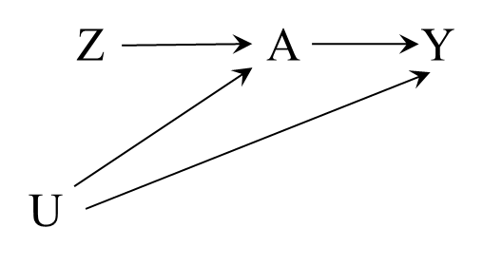
Reminder: Z is an instrument if it meets the 3 instrumental conditions (informal definition)
Z is associated with treatment A
  relevance condition
Z affects the outcome Y only through treatment A
  exclusion restriction
Z does not share causes with the outcome Y
  no confounding for Z

Slide 19
Bounds for the per-protocol effect
10-year risk difference
Very wide bounds
no assumptions
instrumental conditions only
+ assumed maximum risk under screening in “never-takers” of 2% for CRC incidence, 1% for CRC mortality, and 40% for mortality
+ assumed maximum risk under screening in “never-takers” of 1.5% for CRC incidence, 0.75% for CRC mortality, and 30% for mortality
+ assumed maximum risk under screening in “never-takers” of 1% for CRC incidence, 0.5% for CRC mortality, and 20% for mortality
+ additive effect homogeneity
+ multiplicative effect homogeneity

Slide 20
What do we learn from these 2 applications?
Sometimes measuring and adjusting for confounders does not work
  Intractable confounding
In those cases, sometimes we have a variable that meets the instrumental conditions
  like in some randomized trials
    Standard IV estimation is underutilized to estimate per-protocol effects in randomized trials with one-time treatments and all-or-nothing compliance

Slide 21
Key problem in observational data:
Instruments may not exist
If a proposed instrument is not an instrument
  Lots of bias can be introduced
  Proposal: Let’s say “the proposed instrument” rather than “the instrument”
Even if the proposed instrument is truly an instrument
  we cannot prove it
  it can only give us bounds for the effect
  additional assumptions are needed for point estimate
Even if those additional assumptions hold true
  Point estimates will generally have wide 95% CIs
  When the additional assumption is monotonicity, the point estimate measures the effect in an unidentifiable subset of the population

Slide 22
So two approaches to adjust for confounding, but no magic bullet
Correctly measuring and adjusting for confounders
  Fails if important confounders are unmeasured, mismeasured, or incorrectly modeled
Exploiting sources of randomness without measuring the confounders
  Fails if the proposed instrument is not an instrument (or is a weak instrument) or if strong additional conditions do not hold
Both approaches are based on untestable assumptions

Slide 23
But the second approach has an additional, serious limitation
IV estimation and related methods can only be used to try simple causal questions
  Questions involving treatments and exposures that do not change over time
  Yet many treatments and exposures of interest in epidemiology do change over time
Let’s take a step back

Slide 24
Causal inference from observational data
may be viewed as an attempt to emulate a hypothetical randomized experiment or trial
  The target trial
As suggested more or less explicitly by many authors, including Cochran, Rubin, Feinstein, Dawid, Robins…
  Hernán, Robins. Am J Epidemiol 2016

Slide 25
Procedure to answer causal questions
Step #1
  Describe the protocol of the target trial
Step #2
  Option A: Conduct the target trial
  Option B
    Use observational data to explicitly emulate the target trial
    Apply appropriate causal inference methods to estimate the effects of interest

Slide 26
Observational study needs to emulate
Key elements of
target trial protocol
Eligibility criteria
Strategies
Randomized assignment
Start/End follow-up
Outcomes
Causal contrast(s) of interest
Analysis plan
Eligibility criteria
Strategies
Randomized assignment
Start/End follow-up
Outcomes
Causal contrast(s) of interest
Analysis plan

Slide 27
Observational study needs to emulate
Key elements of
target trial protocol
Eligibility criteria
Strategies
Randomized assignment
Start/End follow-up
Outcomes
Causal contrast(s) of interest
Analysis plan
Eligibility criteria
Strategies
Randomized assignment
Start/End follow-up
Outcomes
Causal contrast(s) of interest
Analysis plan
Notes:
All this time we have been talking about 2 approaches to emulate randomization. Time to focus our attention on the strategies

Slide 28
Observational study needs to emulate
Key elements of
target trial protocol
Eligibility criteria
Strategies
Randomized assignment
Start/End follow-up
Outcomes
Causal contrast(s) of interest
Analysis plan
Eligibility criteria
Strategies
Randomized assignment
Start/End follow-up
Outcomes
Causal contrast(s) of interest
Analysis plan
Notes:
All this time we have been talking about 2 approaches to emulate randomization. Time to focus our attention on the strategies

Slide 29
Classification of treatment strategies according to their time course
Point interventions
  Intervention occurs at a single time
  Examples: one-dose vaccination, short-lived traumatic event, surgery…
    Intention-to-treat effects in RCTs are about point interventions
Sustained strategies
  Interventions occur at several times
  Examples: medical treatments, lifestyle, environmental exposures…
  Many (most?) questions are about sustained exposures

Slide 30
Classification of sustained treatment strategies
Static
  a fixed strategy for everyone
  Example: treat with 150mg of daily aspirin during 5 years
Dynamic
  a strategy that assigns different values to different individuals as a function of their evolving characteristics
  Example: start aspirin treatment if coronary heart disease, stop if stroke

Slide 31
Choice of confounding adjustment method depends on type of strategies
Comparison of strategies involving point interventions only
  All methods work
  If all confounders are measured (Approach #1) or the IV estimation conditions hold (Approach #2)
Comparison of sustained strategies
  Generally only g-methods work
  Developed by Robins and collaborators since 1986

Slide 32
Comparative effects of point interventions
Time-fixed treatment implies time-fixed (i.e., baseline) confounding
Approach #1: All methods can correctly adjust for baseline confounding if data on measured baseline confounders are available
  e.g., outcome regression such as logistic or Cox regression
Approach #2: All methods can correctly adjust for baseline confounding if the methods’ assumptions hold
  e.g., IV estimation

Slide 33
Comparative effect of sustained strategies
Time-varying treatments imply time-varying confounders
  possible treatment-confounder feedback
Conventional methods may introduce bias even when sufficient data are available on
  Time-varying treatments and time-varying confounders
G-methods can appropriately handle treatment-confounder feedback
  Sometimes referred to as “causal” methods

Slide 34
Treatment-confounder feedback
Hernán and Robins. Causal Inference. Chapter 20
A₀
L₁
A₁
Y
A_{t}: Antiretroviral therapy
Y: Outcome
L_{t}: CD4 cell count
U: Immunologic status
U
There is treatment-confounder feedback if the time-varying confounders are affected by previous treatment
  Confounder on the causal pathway NOT necessary for bias

Slide 35
G-methods
Parametric g-formula
  Robins 1986
IP weighting of marginal structural models
  Robins 1998
G-estimation of nested structural models
  Robins 1989, 1991
  can incorporate IV–like analyses
Doubly-robust versions
  Bang, Robins, Vanderlaan, Rotnitzky…
  e.g., collaborative targeted maximum likelihood estimation

Slide 36
Conclusions:
When is each approach valid?
Correctly measuring and adjusting for the confounders
  Under possibly strong assumptions
    A sufficient set of confounders is measured
Exploiting sources of randomness without measuring the confounders
  in special cases
    e.g., when an instrument is likely to exist
  under possibly strong additional assumptions
Approach #1: all types of causal questions
Approach #2: questions about point interventions
  Unless combined with g-estimation

