Slide 1



Biomarkers: the Good, the Bad and the Ambiguous
Enrique F. Schisterman, PhD
Epidemiology Branch – DESPR – NICHD

Slide 2
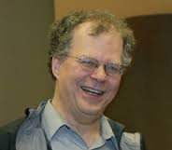
In Memory of My Friend
Sholom Wacholder
“I never feel I truly understand something if I can’t explain it to someone else, orally or in writing,”

Slide 3
Outline
Background
Limit of Detection
Pooling Biomarkers – Hybrid Design
Calibration Curves
Lipid Standardization (if we have time)
Conclusions

Slide 4
Background
Biomarker: A specific physical trait used to measure or indicate the effects or progress of a disease or condition
Newly developed laboratory methods expand the number of biomarkers on a daily basis
  Cost
  Measurement Error
  Causal Link to Disease

Slide 5
Motivation
Preliminary analysis of salivary concentrations of cortisol from the LIFE study
Shipment 1 | n | Mean | SD
Michigan | 85 | 0.40 | 0.19
Texas | 142 | 0.57 | 0.79
P=0.04

Slide 6
Cortisol by Site & Plate

Slide 7
ROC curve—background
Before a marker is used its discriminating accuracy needs to be evaluated
Most commonly used tool - Receiver Operating Characteristic (ROC) curve.
We consider only continuous markers

Slide 8
Distribution of marker in Healthy and Disease
c
c
c

Slide 9
ROC curve – graph of (1-p,q) for all c.
    ROC(1-p)=1-F_{D}(F_{H}⁻¹(p))
ROC defined over all possible thresholds gives the entire range of possible sensitivities and specificities.
Diagnostic accuracy evaluated using measures including the area under the curve (AUC AUC = Prob(X_{H}<X_{D})) and Youden’s index (J)

Slide 10
ROC curve example Complete Separation
1
q(c)
Chance line
p(c)
c
q(c)
0
1 – p(c)
1
  q(c) = 1 and p(c) = 1 for some c

Slide 11
ROC curve example Complete Overlap
1
q(c)
Chance line
p(c)
c
q(c)
0
1 – p(c)
1
  q(c) = 1- p(c), for all c

Slide 12
ROC curve example Partial Separation
1
q(c)
Chance line
p(c)
c
q(c)
0
1 – p(c)
1
  Sensitivity by 1- Specificity
  P( True Pos.) by P( False Pos.)
  across all c

Slide 13
ROC: AUC
1
Area Under the Curve
Overall discriminatory ability
Area under the ROC curve
q(c)
0
1 – p(c)
1
Notes:
A summary measure of the ROC curve is the AUC.

Slide 14
Do Common Laboratory Practices Affect our Estimates of Risk?
Limit of Detection
Measurement Error
Calibration Curves
Lipid Standardization

Slide 15
Outline
Background
Limit of Detection
Pooling Biomarkers – Hybrid Design
Calibration Curves
Lipid Standardization
Conclusions

Slide 16
Reporting of Biomarker Data
ID Z
3.1
1.5
8.4
0.8
5.4
3.2
2.0
5.8
13.4
2.5
1.9
6.1
ID Z
3.1
ND
8.4
ND
5.4
3.2
ND
5.8
13.4
2.5
ND
6.1
ID Z
3.1
1.1
8.4
1.1
5.4
3.2
1.1
5.8
13.4
2.5
1.1
6.1
Report values < threshold as one half the value of the threshold
Report values < threshold as ‘not detected’
Reporting threshold is equal to 2.2

Slide 17
Conventional Determination of the Limit of Detection (LOD)
BLANK SERIES
10.0
5.0
8.1
7.1
4.0
11.3
12.0
8.0
7.7
7.0
Mean = 8.02
Std Dev = 2.53

Slide 18
Example of LOD left-censored data
Blanks
Better LOD?
“True” biomarker

Slide 19
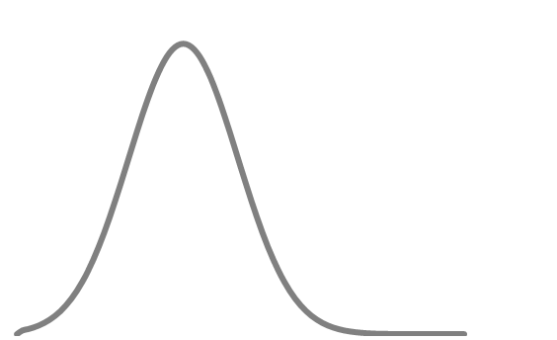
Example of LOD left-censored data
Blanks
“True” biomarker
Observed biomarker (samples)

Slide 20
Why is this a problem?
Comparisons of PCBs in cases and controls
Effect size
Blanks
LOD
Controls—mean PCB
Cases—mean PCB

Slide 21
Approaches for LOD/ missing data
Simplest approach is substitution
  Under certain circumstances yield minimal bias
  Conventionally, values below the LOD are usually
    1. replaced by zero, LOD, LOD/2, LOD/√2
    2. excluded
    3. retained
Model based approaches
  Likelihood models (Perkins et al., AJE 2007)
  Multiple imputation (Harel et al., Epidemiology 2010)
    Schisterman EF, Vexler A, Whitcomb BW, Liu A. AJE 2006

Slide 22
Why is this a problem?
Comparisons of PCBs in cases and controls
LOD
0
LOD/2
LOD
Impute what?

Slide 23
LOD Simulation
Purpose: To evaluate the effect of the handling of values below the LOD on risk estimates
Simulated data from a normal and log normal distribution and varied:
  Effect size
  Variance of PCBs in the exposure group
  LOD level
  Measurement error mean and variance

Slide 24
Effect of Handling of Values < LOD on %Bias
*LOD “low” indicates 1.6 SDs below the mean of controls, resulting in imputed values for a small number of data points. LOD “high” indicates 1 SD above the mean of the controls, resulting in imputed values for a large number of both controls and cases

Slide 25
LOD—Conclusions
Choice of how to handle values below the LOD can result in a loss of accuracy in estimating risk
Retaining observed values below the LOD produces the least biased estimates
Substitution of LOD/√2 for values below the LOD produces not terribly biased estimates

Slide 26
How the LOD Affects the ROC Curve?

Slide 27
LOD: ROC curve
Properly accounting for the mass yields a ROC curve bias toward the null that is identical for any choice of a<d.
ROC
a
* Schisterman, et al.(2005)
Notes:
Schisterman et al. demonstrated ROC techniques for distributions with a mass that is natural to the biomarker levels.
However, this is a mass that is not intrinsic to the true biomarker levels. we made it! Thus the ROC is biased from the true ROC curve.
Additionally, I have shown that this bias exist regardless of the choice of a below d.
This makes the choice of a completely arbitrary when appropriate methods are used.

Slide 28
MLE to correct for LOD
Normal Case
MLE’s of dist.
parameters
where
* Gupta(1952)
Notes:
The Univariate Normal case
Using Gupta’s MLE’s for normal parameters.

Slide 29
MLE to correct for LOD
Normal Case
MLE’s of dist.
parameters
MLE’s of ROC
measures
Invariance
Property
Notes:
I formed a MLE for the AUC

Slide 30
MLE to correct for LOD
Normal Case
MLE’s of dist.
parameters
MLE’s of ROC
measures
CI’s for ROC
measures
2nd Deriv. and
Fisher Info.
Notes:
Through the delta method, I got an estimate of the variance and formed confidence intervals for the AUC.

Slide 31
MLE to correct for LOD
Gamma Case
MLE’s of dist.
parameters
where
* Harter and Moore(1967)
Notes:
Now the Univariate Gamma Case
Using Harter and Moore’s MLE’s for dist para.

Slide 32
MLE to correct for LOD
Gamma Case
MLE’s of dist.
parameters
MLE’s of ROC
measures
Invariance
Property
Notes:
I formed a MLE for the AUC

Slide 33
MLE to correct for LOD
Gamma Case
MLE’s of dist.
parameters
MLE’s of ROC
measures
CI’s for ROC
measures
2nd Deriv. and
Fisher Info.
Notes:
Again, through the delta method, I got an estimate of the variance and formed confidence intervals for the AUC.

Slide 34
LOD: ROC curve
Corrected!
ROC
a
* Schisterman, et al.(2005)
Notes:
Schisterman et al. demonstrated ROC techniques for distributions with a mass that is natural to the biomarker levels.
However, this is a mass that is not intrinsic to the true biomarker levels. we made it! Thus the ROC is biased from the true ROC curve.
Additionally, I have shown that this bias exist regardless of the choice of a below d.
This makes the choice of a completely arbitrary when appropriate methods are used.

Slide 35
Evaluation of MLE
Example
PCB114 levels of 28 cases 51 controls classifying women with and without endometriosis.
1
AUC
Empirical 0.701 (0.576, 0.827)
MLE 0.777 (0.655, 0.899)
0
0
1
*assuming gamma distributions and d=0.005
Notes:
censoring of 76 percent of the controls and 36 percent of the cases

Slide 36
Outline
Background
Limit of Detection
Pooling Biomarkers – Hybrid Design
Calibration Curves
Lipid Standardization
Conclusions

Slide 37
What is pooling?
Physically combining several individual specimens to create a single mixed sample
Pooled samples are the average of the individual specimens
2
p
1

Slide 38
Random Sample of Biospecimens
FULL DATA
N = 40 Individual Biospecimens
RANDOM SAMPLE
Randomly select 20 samples

Slide 39
Pooling Biospecimens
FULL DATA
N = 40 Individual Biospecimens
POOLED DATA
40 samples in groups of 2

Slide 40
Effect of Pooling on Markers

Slide 41
Number of assays required to reach equivalency on ROC Curves

Slide 42
Limit of Detection and Pooling
Unpooled Specimens
Pooled Specimens

Slide 43
Effect of Pooling on Markers Affected by an LOD

Slide 44
Estimation Based on Pooling Using Likelihood Function
Differentiating with respect to
To obtain estimates of
Schisterman et al. Bioinformatics 2006

Slide 45
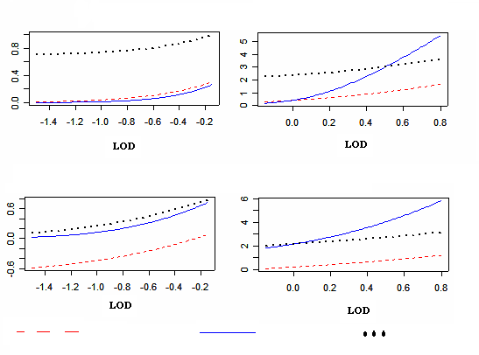
Efficiency of the Mean and Variance
Variance of Estimated Mean
LOD below Mean
LOD above Mean
Variance of Estimated Variance
LOD below Mean
LOD above Mean
FULL DATA
POOLED
RANDOM
FULL DATA
POOLED
RANDOM

Slide 46
Pooling and Random Sampling
Pooling advantages
  Reduces the number of assays we need to test
  Efficiently estimates the mean
  Cost-effective
Random sampling advantages
  Reduces the number of assays we need to test
  Efficiently estimates the variance
  Cost-effective & easy to implement

Slide 47
Hybrid Design: Pooled—Unpooled
Creates a sample of both pooled and unpooled samples
Takes advantage of the strengths of both the pooling and random sampling designs
  Reduces number of tests to perform
  Cuts overall costs
  Gains efficiency (by using pooling technique)
  Accounts for different types of measurement error without replications
    Pooling error
    Random measurement error
    LOD

Slide 48
Setup of Hybrid Design
Hybrid Sample S: X₁,…,X₅,Z₁,…,Z₁₅
Unpooled: X₁,…,X₅
Pooled: Z₁,…,Z₁₅
In General
Hybrid Sample S: X₁,…,X_{[αn]},Z₁,…,Z_{[(1-α)n]}
Unpooled: X₁,…,X_{[αn]}
Pooled: Z₁,…,Z[(1-α)n]
α is the proportion of unpooled samples

Slide 49
Maximum Likelihood Estimators
Random Sampling
Pooling
In order to estimate the variance, α cannot be zero.
Schisterman EF et al, Stat Med 2010

Slide 50
Hybrid Design: Pooled—Unpooled
Create a sample of both pooled and un-pooled samples that takes advantage of the strengths of the pooled and random sample designs
  Reduce number of tests to perform
  Cut overall costs
  Gain efficiency (by using pooling technique)
  Accounts for different types of measurement error without replications
    Pooling error
    Random measurement error
    Limit of detection

Slide 51
Mathematical Setup
Individual Samples
Pooled Samples
p is the pooling group size
Pooling error
Average of p individual samples pooled together

Slide 52
Maximum Likelihood Estimators
Random Sampling
Pooling
In order to estimate the variance, α cannot be zero.

Slide 53
Add in Measurement Error
Individual Samples + ME
Pooled Samples + ME
p is the pooling group size
Measurement error

Slide 54
Hybrid Design Example: IL-6
Measured IL-6 on 40 MI cases and 40 controls
Biological specimens were randomly pooled in groups of 2, for the cases and controls separately, and remeasured
We want to evaluate the discriminating ability of this biomarker in terms of AUC

Slide 55
Hybrid Design Example: IL-6
 | n | α_{x} | α_{y} | AÛC | Var(AÛC)
Empirical | 40 | 1.00 | 1.00 | 0.640 | 0.0036
Hybrid design: Optimal α | 20 | 0.40 | 0.35 | 0.621 | 0.0049
Random sample: α=1 | 20 | 1.00 | 1.00 | 0.641 | 0.0071
Hybrid design reduced the variability of Var(AÛC) by 32% as compared to taking only a random sample

Slide 56
Summary—Hybrid Design
Hybrid design is a more efficient way to estimate the mean and variance of a population
Cost-effective
Yields estimate of measurement error without requiring repeated measurements
Here we focus on normally distributed data, but can be applied to other distributions as well

Slide 57
Outline
Background
Limit of Detection
Pooling Biomarkers – Hybrid Design
Calibration Curves
Lipid Standardization
Conclusions

Slide 58
Measurement of G-CSF
Chemiluminescence assays
  96-well plate
  Antibody against the biomarker of interest
  Set of standards of known biomarker concentration included in each batch
  Set of samples (concentration unknown)
  Light emitting molecule binds to bound biomarker
Notes:
How we went about measuring GCSF – chemiluminescence assays

Slide 59
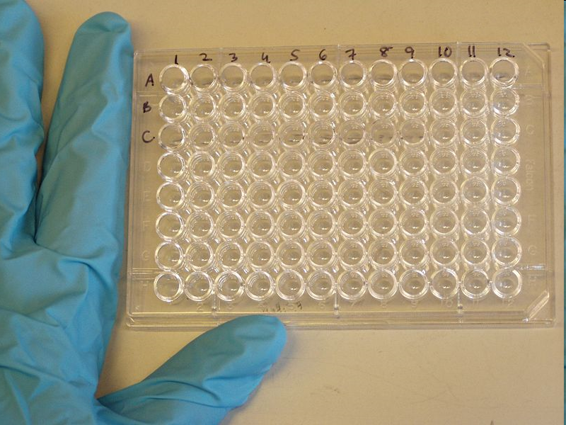

Slide 60
Measurement of Cytokines
Cytokines are not measured directly
  Antibodies against analyte(s) coat wells
Notes:
Pretty pictures
Solid phase is antibodies linked to gel or some coating over 96 well plates (shown in later slides)

Slide 61
Measurement of Cytokines
  Samples added, analyte binds to antibodies
  Unbound proteins are washed away
Notes:
Samples are added of either known or unknown amount of the analyte of interest. The solid-phase bound antibody binds only to the antigen against which it is directed – here indicated as the red dots vs green dots. The specificity of the assay (i.e., non-cross reactivity) is a function of the antibody-antigen relation and the size and variability of the binding region (again, the dots on the yellow rods).
A rinse step then clears all unbound protein from the fluid filled well.

Slide 62
Measurement of Cytokines
  A ‘tag’ is added to the assay that binds to the protein – antibody complex that produces color
Notes:
Finally, an antigen-chromophore is added to the well that indescriminately binds to proteins and is countable because of the chromophore. Prior to ELISA assays there were radioassays where this tag part was labelled with radioactivity to allow quantification

Slide 63
Measurement of Cytokines
  A ‘tag’ is added to the assay that binds to the protein – antibody complex that produces color
  The intensity of the color is measured
Notes:
Here, though, after a solution is added to the wells, the chromophore produces light that can be measured

Slide 64
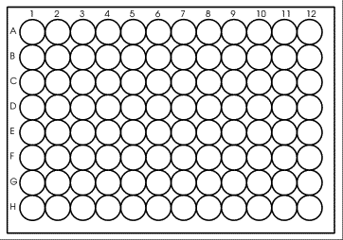
ELISA/Multiplex Layout
Step 1: prepare antibodies mixture and add to plate
Step 2: prepare calibrators, add to plate
Step 3: prepare unknowns, add to plate
Notes:
A 96 well plate based assay and layout with wells with coordinates A1 – H12. Steps are to prepare solid phase, then prepare a set of standards and then add the prepared unknowns

Slide 65
Use of Chemiluminescence Assays for Measuring Protein Concentrations
Use calibration to convert relative measures to the desired unit of concentration
  From optical density in relative fluorescence units (RFU) to concentration in pg/mL
Current practice is per assay calibration
  Results in potentially large calibration datasets used only minimally in current practice
Notes:
The inferring step relies upon the calibration curve. This curve converts the units as measured (RFU) into one that is meaningful (picograms per milliliter.
Conventionally, this is done for each and every plate/assay/batch that is run. Since each plate generally uses 8 times 2 replicates columns for calibration, this can add up in large studies. The number of calibrators by convention is meant to best reflect the function linking od and conc

Slide 66
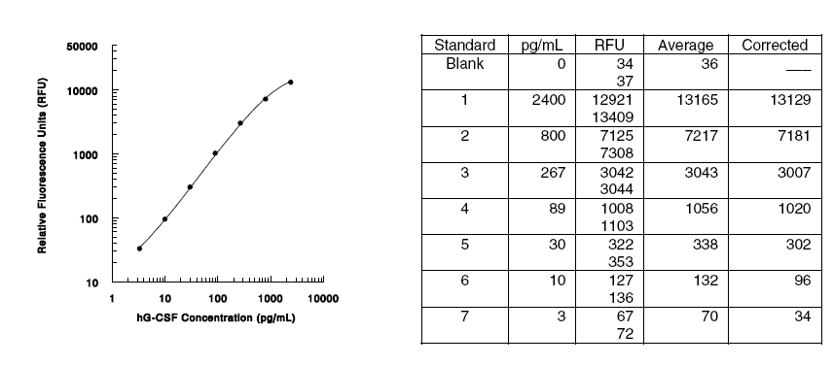
Calibrating the Assay:
The Standard Curve
Notes:
As shown here…

Slide 67
Calibrating the Assay:
The Standard Curve
The human G-CSF standard curve is provided only for demonstration
A standard curve must be generated each time an assay is run, utilizing values from the Standard Value Card included in the Base Kit
Potential variation in the relation between relative fluorescence and concentration
  Chromophore potentially affected by temperature, humidity, etc.

Slide 68
G-CSF and Miscarriage in the CPP
Case-control study nested in the Collaborative Perinatal Project study cohort
  462 miscarriage cases
  482 non-miscarriage controls
Serum biospecimens from early pregnancy, prior to miscarriage onset
For n = 944, 24 assays were used
Notes:
Why run each batch?
So, conventional approach entails a full calibration curve for each batch and using each curve independently of all others. That is, the calibration curve is applied to the data from a specific batch and only to that batch.

Slide 69
Notes:
These are the results we observed in the CPP following a batch-specific calibration approach

Slide 70
This estimate is based on the conventional
batch specific approach
Notes:
These are the results we observed in the CPP following a batch-specific calibration approach – here just focusing on GCSF. Both results are from conditional logistic regression models

Slide 71
Objective
Question: Is the current practice of standard batch-specific calibration the best use of information?
To evaluate the effect of different approaches for calibration models on risk estimation
To assess bias associated with different approaches
Notes:
Our aim was to consider alternatives to this approach. As a given, we consider data where each batch includes the calibration series and the unknowns, and then evaluate other approaches to using each set of calibrators independent of the others. Our first interest was to see if the different approaches would have any impact on risk estimation in the dataset we were using. Secondarily, whatever variation we might observe in the real data, we wanted to see how those differences were related to bias

Slide 72
Data from the calibration experiments
24 batches, each with 7 known concentrations measured in replicate
  Batches varied by
    Shape
    Location
    Agreement between replicates
    Presence of outliers

Slide 73
Batch 1 Calibration Curve – G-CSF
Standard 1 – undiluted (conc = 6000 pg/mL)
Measured optical density
*All calibration data (in log10)
Fixed ‘known’ concentration
Notes:
Replicates shown here as pairs in columns. These points are for the most concentrated of the standards with ‘known’ concentration = 6000

Slide 74
Batch 1 Calibration Curve – G-CSF
Standard 2 – 1/3rd dilution (conc = 2000 pg/mL)
Measured optical density
Fixed ‘known’ concentration
Notes:
Replicates shown here as pairs in columns. These points are for the first dilution of the standard with ‘known’ concentration = 2000

Slide 75
Batch 2 Calibration Curve – G-CSF
Measured optical density
Fixed ‘known’ concentration
Notes:
Variability in the calibration series:
Variability results across the range of calibrators

Slide 76
Batch 3 Calibration Curve – G-CSF
Measured optical density
Fixed ‘known’ concentration
Notes:
Variability in the calibration series:
Variability results across the range of calibrators

Slide 77
Batch 6 Calibration Curve – G-CSF
Measured optical density
Fixed ‘known’ concentration
Notes:
Variability in the calibration series:
Some slightly sigmoidal and with minimal interreplicate variability

Slide 78
Batch 9 Calibration Curve – G-CSF
Measured optical density
Fixed ‘known’ concentration
Notes:
Variability in the calibration series:
Others decidedly sigmoidal

Slide 79
Batch 10 Calibration Curve – G-CSF
Measured optical density
Fixed ‘known’ concentration
Notes:
Variability in the calibration series:

Slide 80
Batch 21 Calibration Curve – G-CSF
Measured optical density
Fixed ‘known’ concentration
Notes:
Variability in the calibration series:
Sometimes extreme, but still producing an assay measurement

Slide 81
Batch 22 Calibration Curve – G-CSF
Measured optical density
Fixed ‘known’ concentration
Notes:
Variability in the calibration series:
Sometimes extreme, but still producing an assay measurement and with potentially large leverage

Slide 82
Batch 24 Calibration Curve – G-CSF
Measured optical density
Fixed ‘known’ concentration
Notes:
Variability in the calibration series:
Sometimes extreme, but still producing an assay measurement and less potential leverage

Slide 83
All Calibration Curves Collapsed – G-CSF
Measured optical density
Fixed ‘known’ concentration
Notes:
Variability in the calibration series:
Sometimes extreme, but still producing an assay measurement and less potential leverage

Slide 84
Effect of Calibration Method on Logistic Regression Results

Slide 85
Simulation Study
Generate dataset with:
  True biomarker concentration
  True effect on risk
  Overall relation between concentration and RFU
  Batch variability
  Occasional outliers
Simulate calibration experiments to estimate RFU – concentration relation according to each approach
Assess bias and variance of estimators from risk models

Slide 86
Simulation Study:
The Biomarker
Biomarker: exp(X ~ N(5,1))
Miscarriage risk: OR = 1.05, 1.15 or 1.65
β={0.05, 0.14, 0.50}
Conc. and OD: OD determined through a single function

Slide 87
Summary of simulation study results
Comparison of shape, model for β = 0.14
Collapsed
Mixed
Batch-specific
0.14
^
β
Linear
Curvilinear
Linear
Curvilinear
FORWARDS
REVERSE
Whitcomb et al, Epidemiology 2010

Slide 88
Conclusions
Underestimation of effects due to calibration approach has broad implications
Use of conventional batch-specific approaches performed poorly
  Greatest bias to estimates in simulations
  Most prone to loss of data for batches with failure of some calibration points

Slide 89
Outline
Background
Limit of Detection
Pooling Biomarkers – Hybrid Design
Calibration Curves
Lipid Standardization (later if we have time)
Conclusions

Slide 90
Outline
Background
Limit of Detection
Pooling Biomarkers – Hybrid Design
Calibration Curves
Lipid Standardization
Conclusions

Slide 91
Do Common Laboratory Practices Affect our Estimates of Risk?
YES!
Limit of Detection
  Request the observed values
  Design away using hybrid methods and overcome cost, LOD and ME
Calibration Curves
  Study Design should include a calibration curve plan
Standardization
  Don’t do it!

Slide 92
Thank you!
Questions?

Slide 93
Future Direction
Limit of detection: Linking the CV, AUC and calibration.
Reliability index could be applied such that
Coefficient of variation is used by labs during calibration
For normally distributed biomarkers, we can use these two summaries such that

Slide 94
Limit of detection: Linking the CV, AUC and calibration.
Reliability index could be applied such that
Coefficient of variation is used by labs during calibration
For normally distributed biomarkers, we can use these two summaries such that

Slide 95
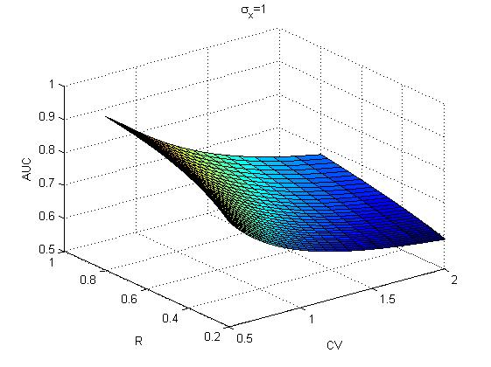
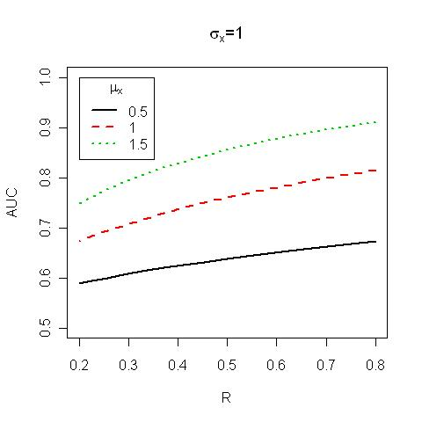
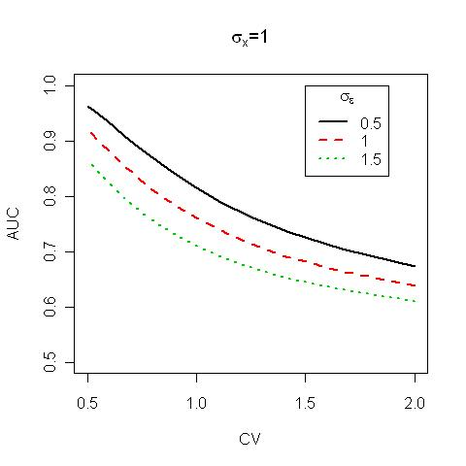
We can investigate the relation between these factors easily because R and CV are relative measures.

Slide 96
This is of particular importance because for certain types of
measurement processes, the Limit of detection is based on the CV and a more appropriate cut-point might be better generated using ROC methods for differentiating between signal and noise.

Slide 97
modeling calibration data dependent/independent variables
Assay yields OD for observations in the main dataset
‘Forward’ (regression calibration)
  Estimate & use calibration equations in the same order, i.e.:
‘Reverse’
  Estimate calibration equations, flip for calibration, i.e.:
Notes:
Forward vs reverse

Slide 98
modeling calibration data treatment of batch
Approach to batch, OD as independent variable
use calibration data to model:
con_{ijk} = α + βOD_{ijk} | Collapsed
con_{ijk} = α_{k} + β_{k}OD_{ijk} | Batch-specific effects
con_{ijk} = α* + β*OD_{ijk} + a_{j} + b_{j}OD_{ijk} | Mixed effects
i = standard 1 – 7
j = replicate 1 – 2
k = batch 1 – 24
Notes:
Other effects including day, technicians, other factors

Slide 99
modeling calibration data treatment of batch
Approach to batch, concentration as dependent variable
use calibration data to model:
OD_{ijk} = α + βcon_{ijk} | Collapsed
OD_{ijk} = α_{k} + β_{k}con_{ijk} | Batch-specific effects
OD_{ijk} = α* + β*con_{ijk} + a_{k} + b_{k}con_{ijk} | Mixed effects
i = standard 1 – 7
j = replicate 1 – 2
k = batch 1 – 24

Slide 100
Data calibration
Parameters estimated for linear and curvilinear models
For concentration as dependent
  Unknown concentrations calibrated from estimated f(OD)
Notes:
From the calibration experiment parameter estimates, concentration in the unknowns was determined for the linear models, and using the quadratic formula for the curvilinear models.

Slide 101
Data calibration
Parameters estimated for linear and curvilinear models
For concentration as dependent
  Unknown concentrations calibrated from estimated f(OD)
Notes:
From the calibration experiment parameter estimates, concentration in the unknowns was determined for the linear models, and using the quadratic formula for the curvilinear models.

Slide 102
Data calibration
Parameters estimated for linear and curvilinear models
For OD as dependent
  Unknown concentrations calibrated as:
Notes:
From the calibration experiment parameter estimates, concentration in the unknowns was determined for the linear models, and using the quadratic formula for the curvilinear models.

Slide 103
Data calibration
Parameters estimated for linear and curvilinear models
For OD as dependent
  Unknown concentrations calibrated as:
Notes:
From the calibration experiment parameter estimates, concentration in the unknowns was determined for the linear models, and using the quadratic formula for the curvilinear models.

Slide 104
Simulation study the calibration relation
7 known concentrations in replicate/batch
Measured OD for each true concentration
  True overall relation by 4 parameter logistic

Slide 105
Simulation study the calibration relation
7 known concentrations in replicate/batch
Measured OD for each true concentration
  True overall relation by 4 parameter logistic
  Random batch variability
  Random failures with frequency 0.01

Slide 106
Calibration approaches
Calibration models varied as regards:
  Dependent/independent variable
    Measured OD and fixed known amount
  Shape (linear or quadratic in log)
  Treatment of batch
    Disregard (collapsed)
    Model as fixed effect (batch-specific)
    Model as random effect
Notes:
Approaches we considered for calibration:
Order of calibration, shape of function (considered linear and quadratic – square term), and then what to do with information regarding batch

Slide 107
Results
Calibration models
  Plots of cross-classification
Effects on risk estimation
Simulation study
Notes:
For results, I will start by showing plots of the data as calibrated by different approaches to give an idea of how much agreement/disagreement there is between the methods. Then, I will show the results of logistic regression models of miscarriage using data from the cases and controls as calibrated by each approach to illustrate the effects on risk estimation. Finally, I will talk about the results of the simulation study to determine bias by method.

Slide 108
All batches combined – outliers in the calibration set
1
0
1
2
3
Notes:
With outliers – all batches overall. Not too much effect on collapsed

Slide 109
All batches combined – outliers in the calibration set
1
0
1
2
3

Slide 110
All batches combined outliers in the calibration set
All calibration data (in log10), with batch-specific regression
Notes:
But more of an impact on batch specific

Slide 111
All batches combined outliers in the calibration set
All calibration data (in log10), with batch-specific regression

Slide 112
Impact of calibration on risk estimation output from logistic regression
Assay response data were calibrated to convert OD to concentration according to each of the previously described methods
Logistic regression relating miscarriage risk to log₁₀ levels of GCSF were performed

